Slide 1
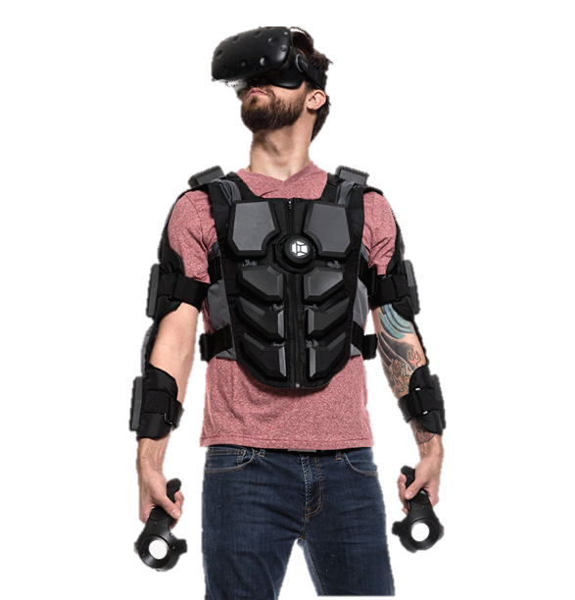
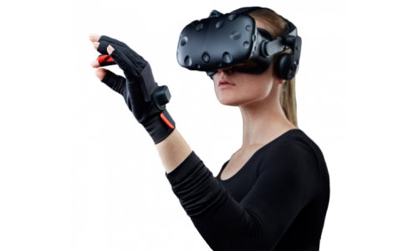
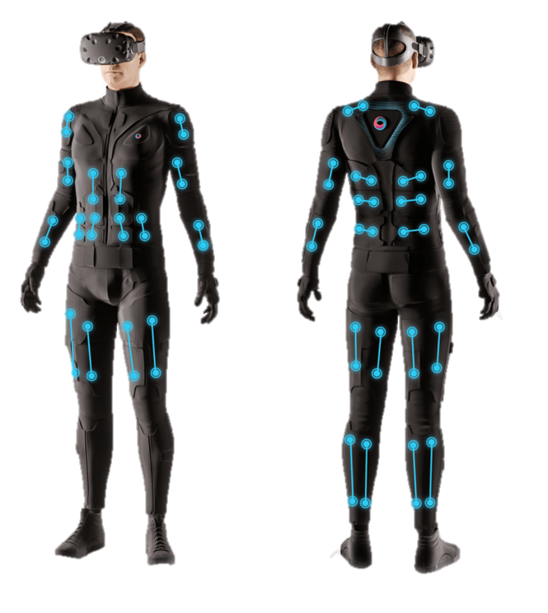
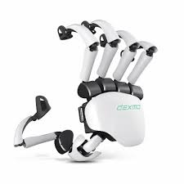
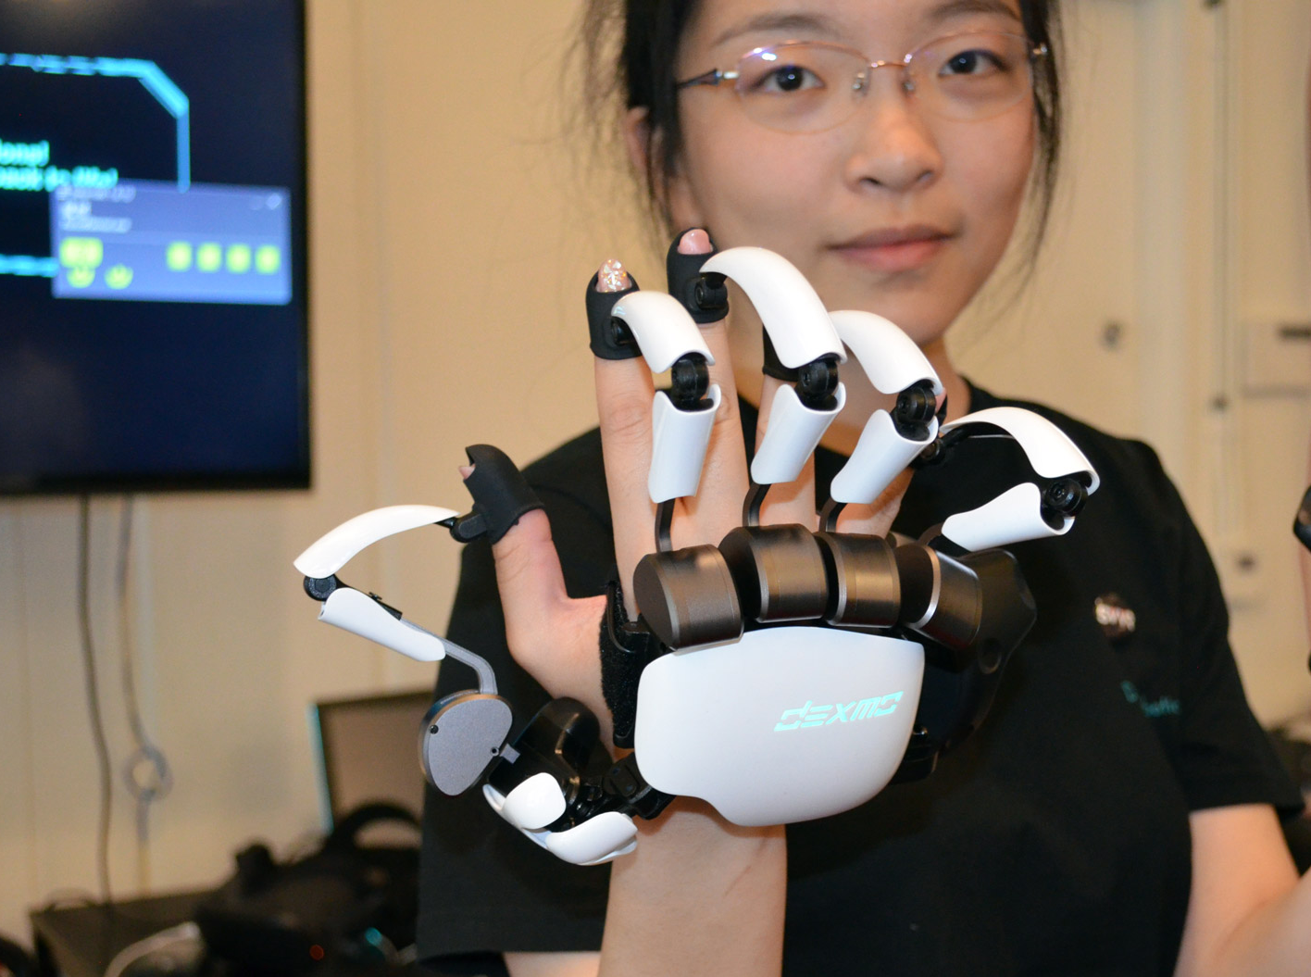
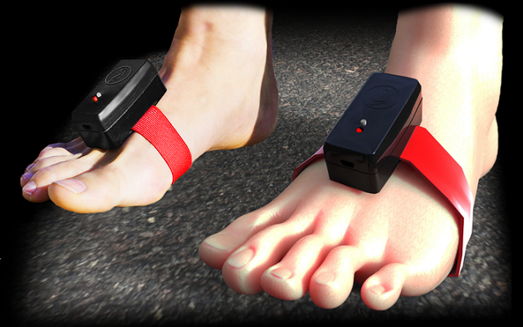
Haptic
Haptic
Manus VR
bHaptics Tactot Vest
Teslasuit
Dexmo Haptic
Stompz Feet Controlled VR
Recreation of the sense of touch via applied motions, vibrations, and forces
Notes:
Outfitted with sensors on the fingers as well as an overall position/orientation tracking equipment.
Enables natural interaction with virtual objects by hand gesture recognition.

Slide 2
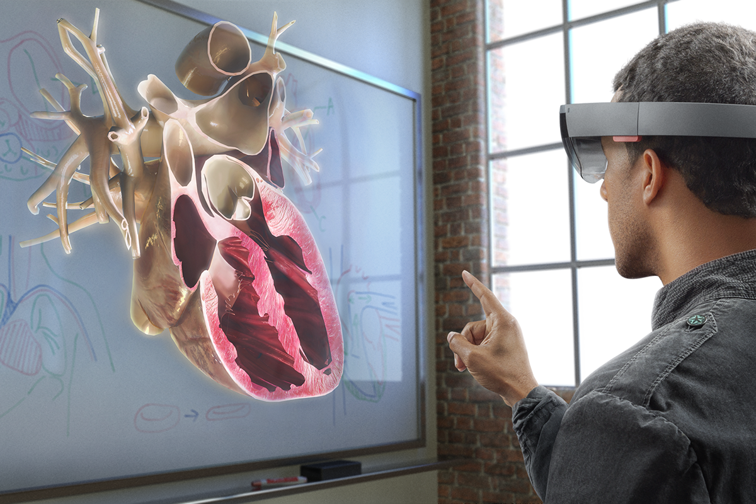
Interaction
Direct Manipulation: Interaction Mechanisms
Direct user control (markerless motion-capture-based)
Physical control (worn or held sensors)
Virtual control (embedded within environment)
Agent control (voice/gesture-based interaction with agent)

Slide 3
In-class Activity
In-Class Activity
AR, VR, MR: features and connectedness with reality

Slide 4
results
In-Class Activity
Yes
Yes
Yes & No
Yes
Yes
Yes
Yes
Yes
Yes
Yes
Yes
Yes
Yes
Yes
Source, adapted from: http://www.pwc.com/us/en/technology-forecast/augmented-reality/augmented-reality-road-ahead.html
AR, VR, MR: features and connectedness with reality

Slide 5
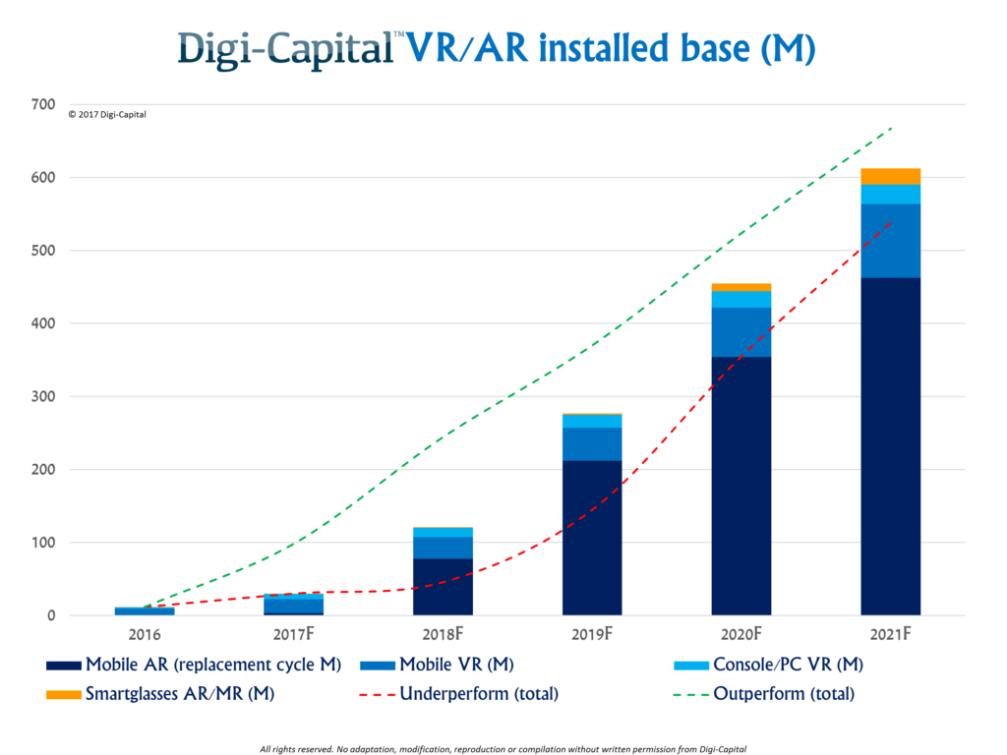
Installations
Installations and Forecast Revenues
Notes:
After mixed year, mobile AR to drive $108 billion VR/AR market by 2021

Slide 6
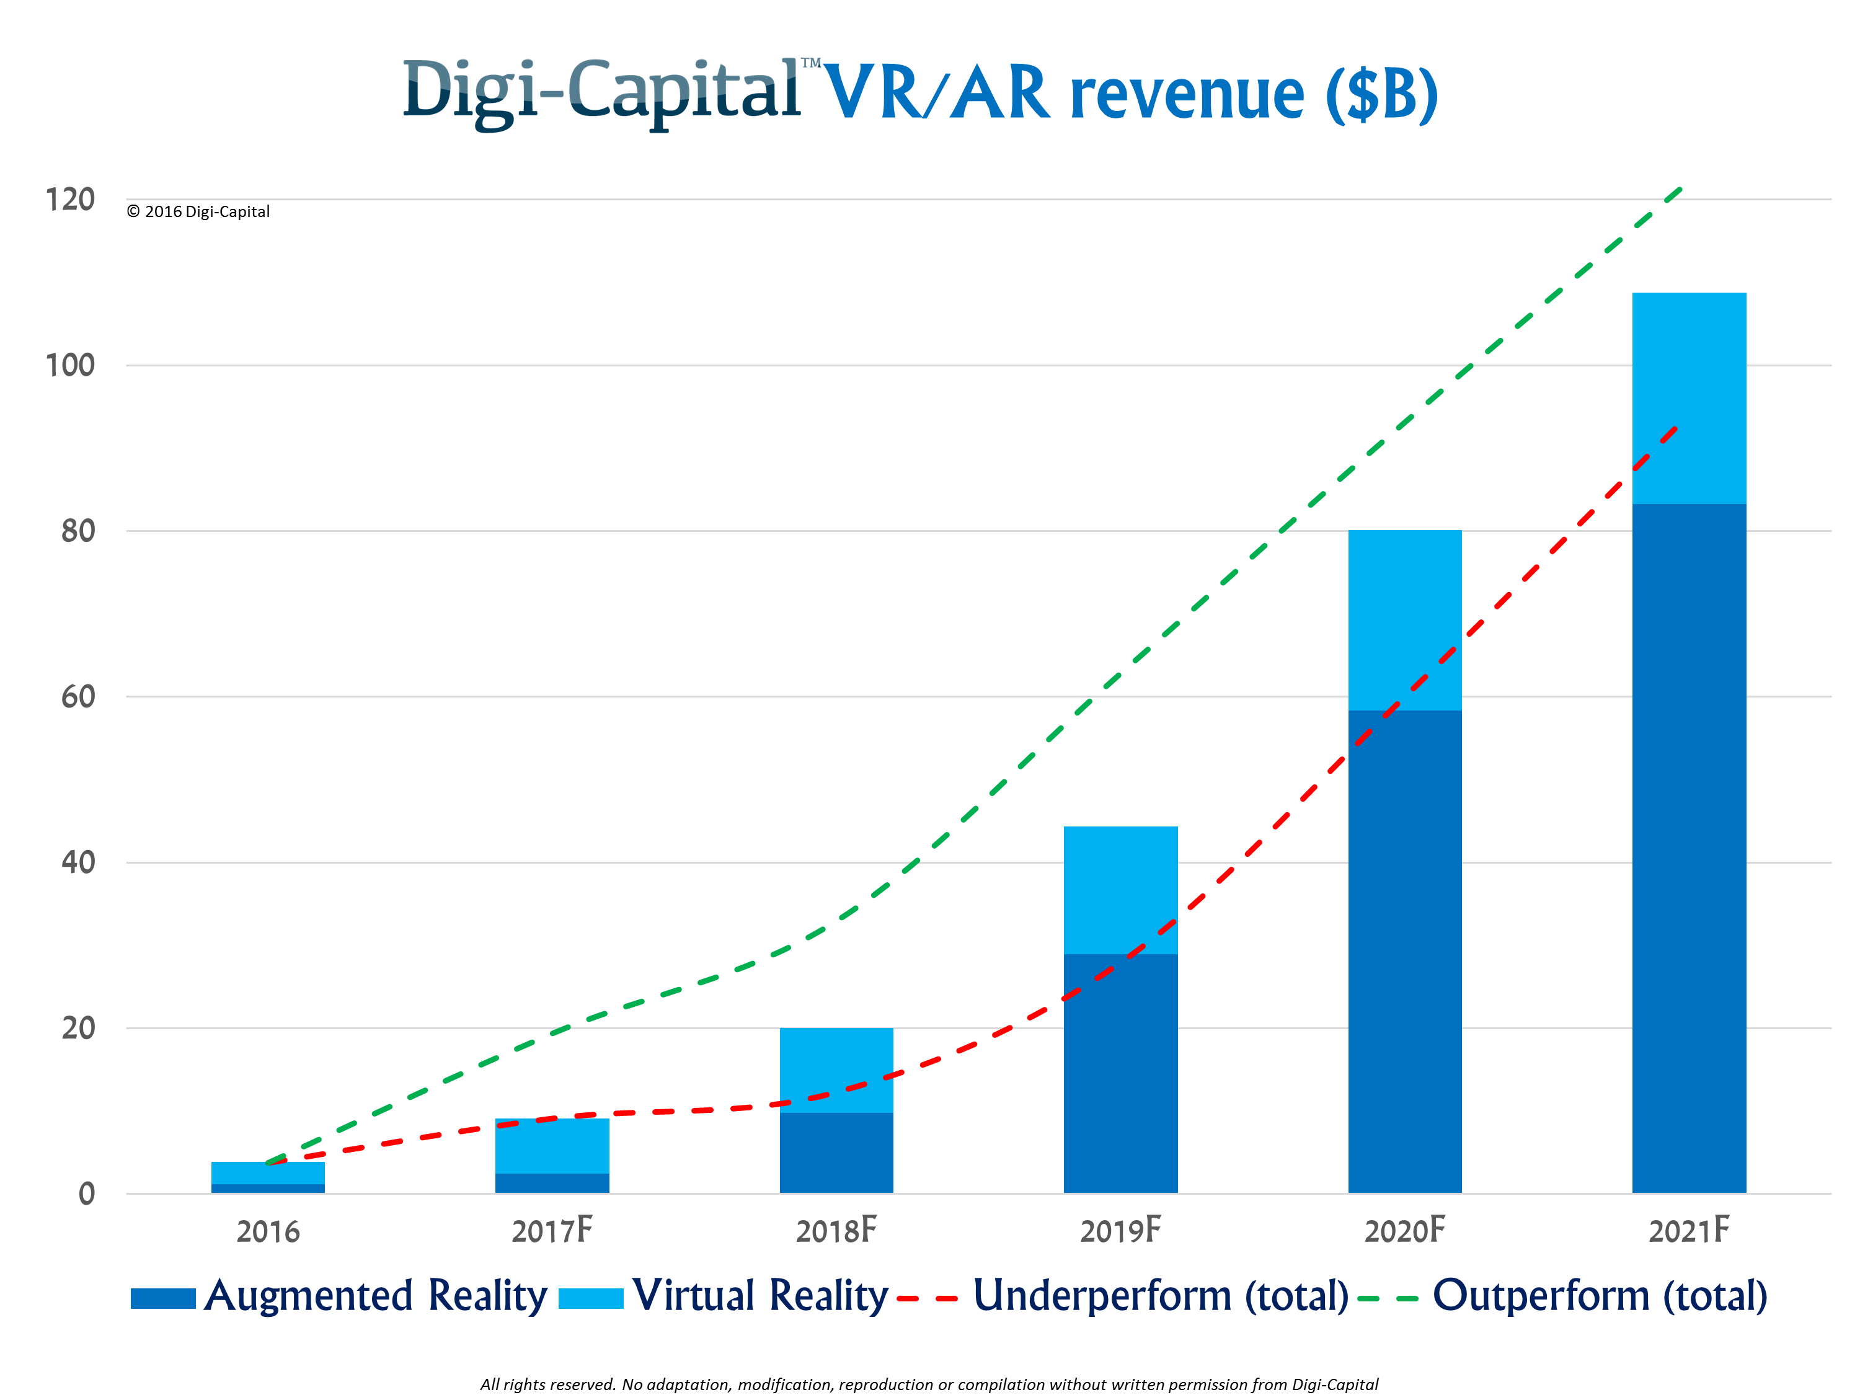
Revenues
Installations and Forecast Revenues

